Slide 1
MDRT Oceania Charity Walk
Queen Charlotte Track
New Zealand

Slide 2
MDRT Charity Walk
Do you want to help others?
Should you exercise more?
Do you want to lose a little weight?
Do you need a break from the grind?
Want to raise your spirits?
Get back to Life basics?
Want to experience natures beauty?

Slide 3
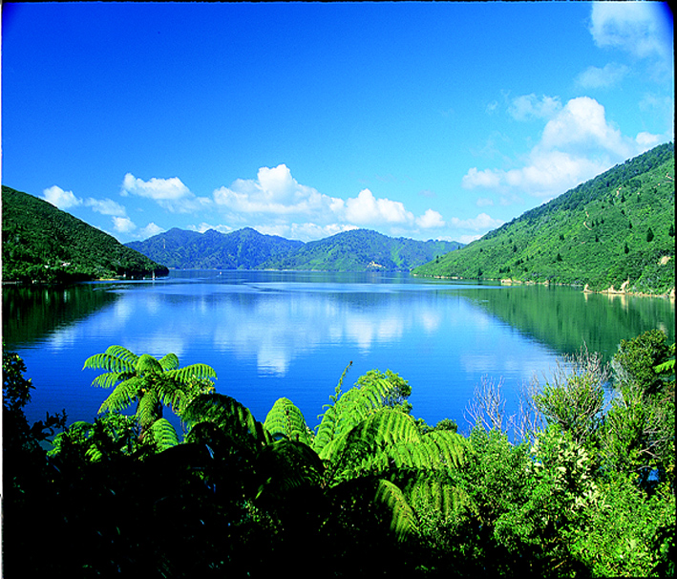
MDRT Charity Walk

Slide 4
MDRT Charity Walk
Queen Charlotte Track on Marlborough Sound
Aim is to raise funds for the Christchurch earthquake victims
Three day walk – 70 kms

Slide 5
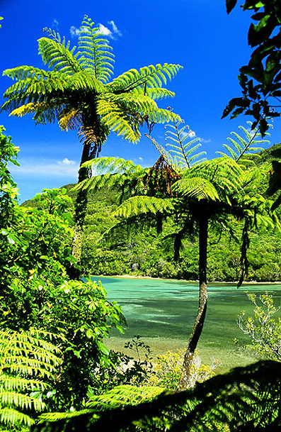
MDRT Charity Walk

Slide 6
MDRT Charity Walk
Land in NZ on the Wednesday 9th November
Bus from Airport to Picton
Customised 3 day Walk
Bus to Airport (or you can extend your trip)
Head home on the Sunday 13th

Slide 7
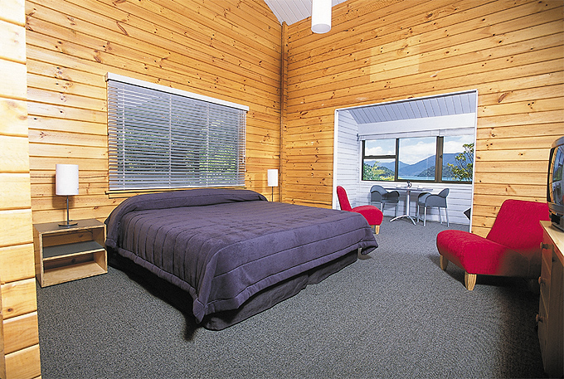
MDRT Charity Walk

Slide 8
MDRT Charity Walk
Package includes transit costs to and from airport, welcome BBQ cruise, water transport around the Sound, experienced guides, breakfast lunch and dinner during the walk, twin share accommodation and luggage transfers:
Discounted cost $1,950 per person (Aus)

Slide 9
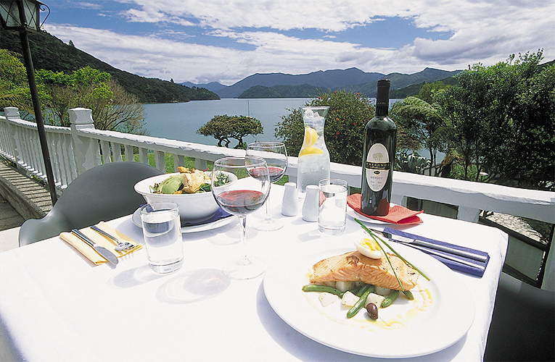
MDRT Charity Walk

Slide 10
MDRT Charity Walk
You do not need to be a member to join us
Spouses are welcome
Each person to raise their own donations – corporate and individual sponsorship welcome
Commit yourself now – you won’t regret it!

Slide 11
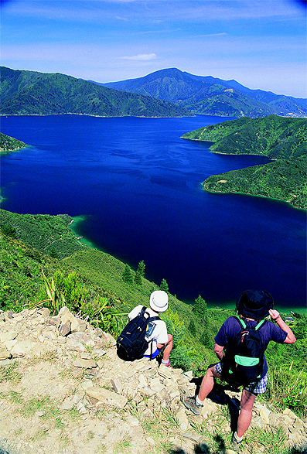
MDRT Charity Walk

